Slide 1

CMR Technical Campus Department of CSE
Major Project
Project Title: Deep Learning and NLP-Based Emotion-Aware Conversational Agents
Project Guide:​
Name:​ Mr. K. Ranjith Reddy
Designation: Assistant professor
Presented By:​
Batch No: 04
Roll No: 227R1A0506 Name: Ankith Kumar Pandey
Roll No: 227R1A0555 Name: S. Anjitha Reddy
3. Roll No: 227R1A0530 Name: K. Radha

Slide 2
Index
Introduction and overview of the project
Abstract
Literature Review.
Problem Definition
Proposed system.
Objectives
Architecture
UML Diagrams
Analysis.
Expected Output.

Slide 3
Department Vision and Mission
Vision
To Provide quality education and a conducive learning environment in computer engineering that foster critical thinking, creativity, and practical problem-solving skills.
Mission
M1: To educate the students in fundamental principles of computing and induce the skills needed to solve practical problems.
M2: To provide State-of-the-art computing laboratory facilities to promote industry-institute interaction to enhance student’s practical knowledge.
M3: To Inculcate self-learning abilities, team spirit, and professional ethics among the students to serve society.

Slide 4
Introduction
Traditional conversational agents focus on interpreting the meaning of user inputs but lack the ability to detect and adapt to the emotional state of the user. This limitation results in interactions that feel mechanical, unempathetic, and disconnected from human communication norms.
Advancements in Deep Learning and Natural Language Processing (NLP) have enabled the development of systems capable of detecting emotions from textual, vocal, and visual cues. By incorporating emotion recognition into conversational agents, interactions can become more natural, context-aware, and emotionally intelligent. This has significant applications in mental health support, customer service, education, and entertainment.

Slide 5
Abstract
Conversational agents have become integral to modern human-computer interaction, yet most lack the ability to understand and respond appropriately to a user’s emotional state. This limitation reduces user engagement, empathy, and effectiveness, particularly in sensitive domains such as mental health support, education, and customer service. This project proposes a deep learning and Natural Language Processing (NLP)-based framework for building emotion-aware conversational agents capable of detecting and adapting to user emotions in real-time. The system employs transformer-based models (e.g., BERT, RoBERTa) for contextual emotion classification, optionally enhanced through multimodal inputs such as speech tone and facial expressions. A reinforcement learning-based dialogue manager selects responses that align with the detected emotion, ensuring consistency and empathy throughout the conversation. The proposed solution is designed for scalability, enabling deployment across multiple application areas while maintaining high accuracy, contextual relevance, and emotional appropriateness. This integration of emotion recognition and adaptive dialogue generation promises to advance the next generation of human-like, emotionally intelligent AI assistants.

Slide 6
Literature Review
Approach | Strengths | Limitations
Rule-based Chatbots | Simple, predictable | No context or emotion detection
ML-based NLP (RNN/LSTM) | Handles sequences, basic context | Weak with long-range context, poor emotion understanding
Transformer-based NLP (BERT, RoBERTa) | Strong context understanding, fine-tuning support | Needs large data, high compute
Emotion Detection (Text-only) | Detects emotional tone | Misses vocal/facial cues, sarcasm issues
Multimodal Recognition | High accuracy with multiple cues | Complex, needs multimodal data
Emotion-aware Dialogue | Emotion-adapted responses | Needs fine-tuning to avoid bias

Slide 7
Problem Definition
Existing conversational agents lack emotional intelligence—they often respond with grammatically correct but emotionally inappropriate messages. While sentiment analysis tools exist, they typically operate in isolation without integrating context-aware deep learning dialogue systems.
Furthermore, multimodal emotion detection remains underutilized due to high complexity. There is a gap for a scalable, adaptable framework that fuses deep learning-based emotion recognition with NLP-driven dialogue generation in a seamless, real-time system.

Slide 8
Proposed System
The proposed Emotion-Aware Conversational Agent consists of:
Emotion Detection Layer
Uses transformer-based NLP models for text emotion classification.
Optional multimodal integration with speech tone analysis and facial emotion recognition.
Dialogue Management Layer
Reinforcement Learning-based policy to select emotionally adaptive responses.
Context tracking to ensure emotional consistency.
Response Generation Layer
Uses fine-tuned generative models (e.g., GPT variants) for natural responses.
Adjusts tone, empathy level, and language style based on detected emotion.

Slide 9
Objectives
Build a robust emotion detection system using deep learning + NLP.
Integrate emotion-aware dialogue management for personalized interactions.
Achieve high accuracy in real-time emotional state classification.
Maintain conversational context for emotionally consistent responses.
Ensure scalability and adaptability for multiple domains (healthcare, education, customer service).

Slide 10
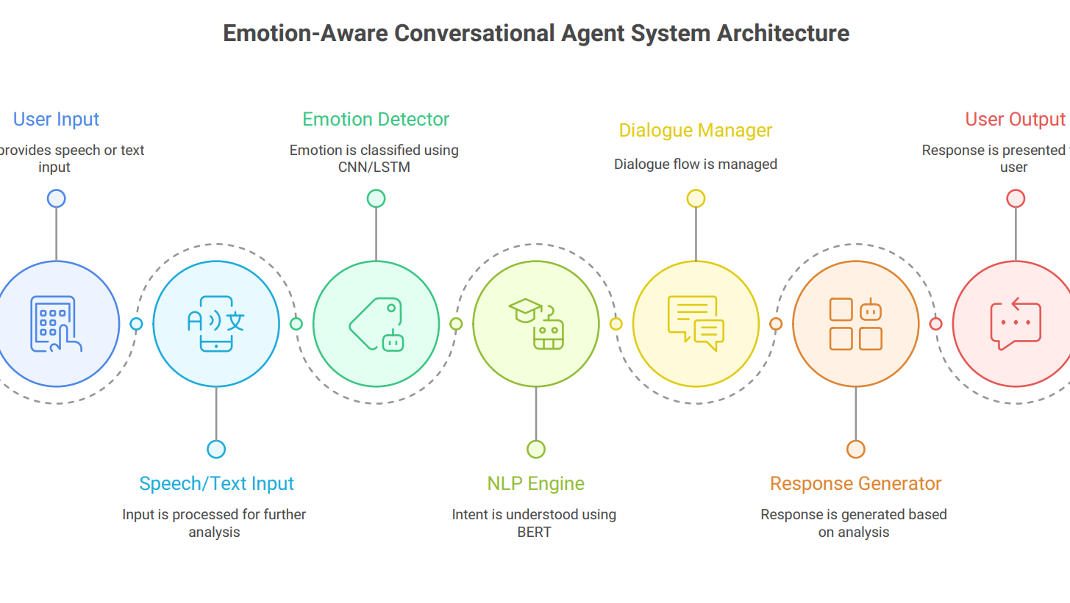
Architecture

Slide 11
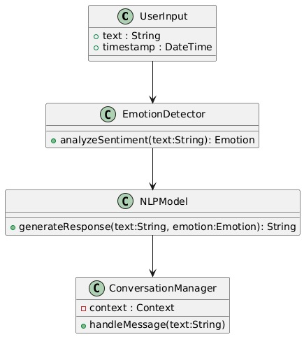
UML Diagrams
Class Diagram :

Slide 12
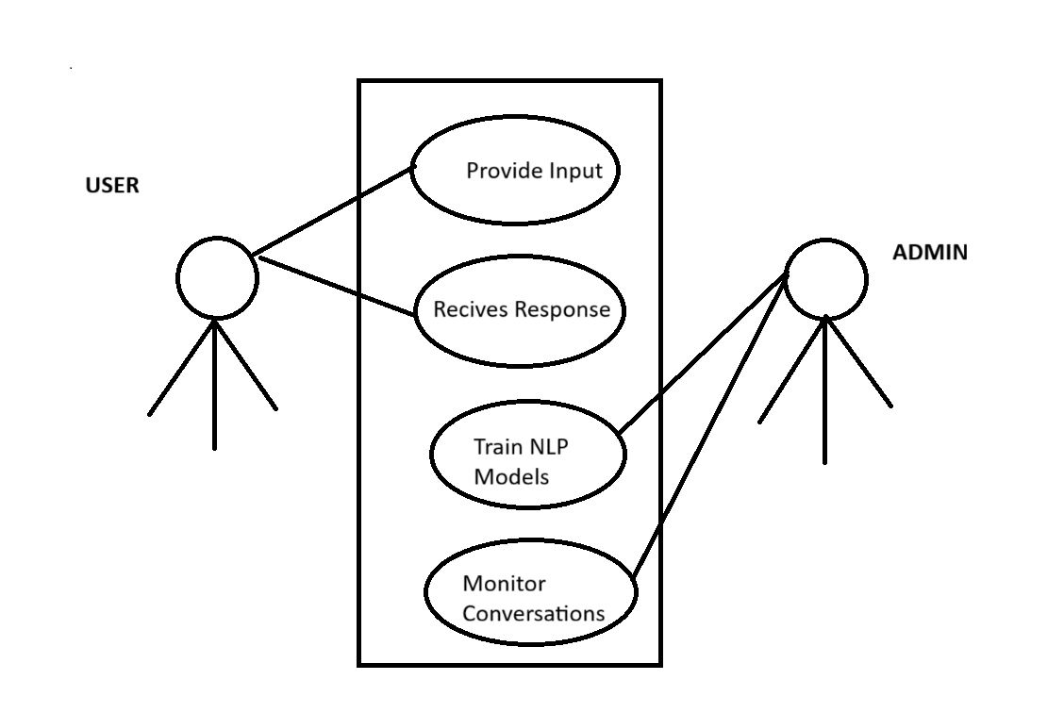
Use Case Diagram :

Slide 13
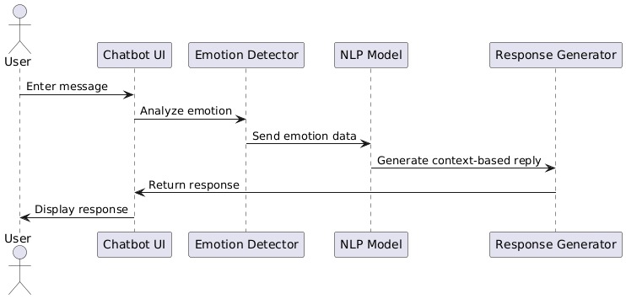
Sequence Diagram :

Slide 14
Requirement Analysis​
Hardware Requirements
Processing Unit – High-performance GPU (e.g., NVIDIA RTX 3060 or higher) or cloud-based GPU service for deep learning model training and inference.
Memory – Minimum 16 GB RAM for smooth dataset handling and real-time processing.
Storage – At least 512 GB SSD for datasets, model checkpoints, and application files.
Software Requirements
Programming & Frameworks – Python 3.x, PyTorch/TensorFlow, Hugging Face Transformers for NLP.
Supporting Libraries – OpenCV (for visual emotion recognition), NLTK/Spacy (for text preprocessing), SpeechRecognition & librosa (for audio analysis).
Deployment Tools – Flask/FastAPI for API integration, MongoDB/PostgreSQL for data storage, and Docker for containerized deployment.

Slide 15
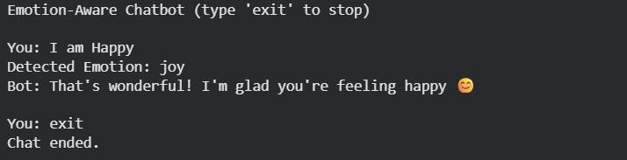
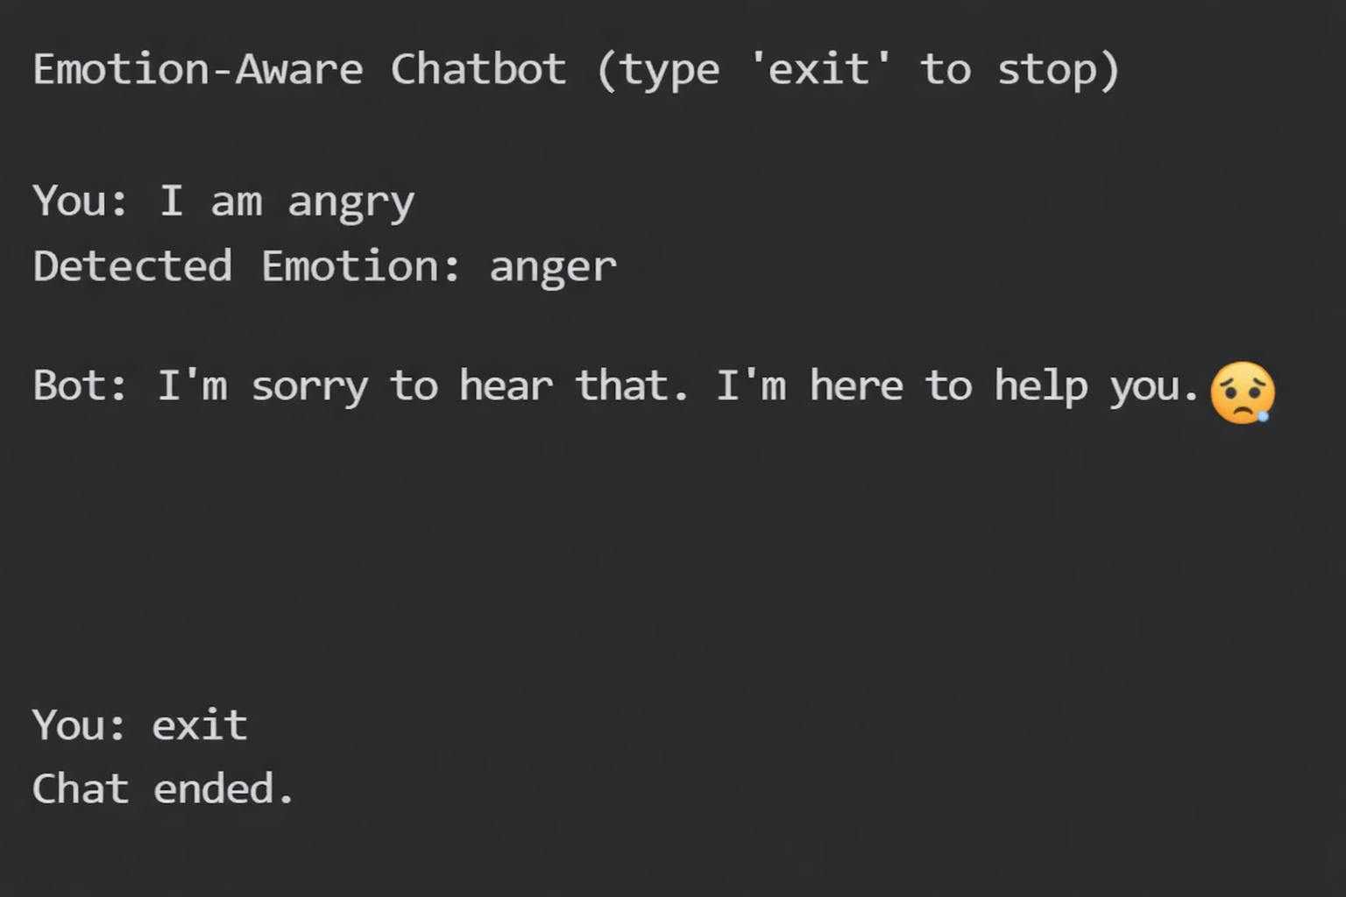
Output

Slide 16
THANK YOU

